Slide 1
Fertility Rates Overview
Group 09 – Yongyeon Jang, Alessandro Seghini
Date: June 2025

Slide 2
Project Goal
Analyze how fertility rates have changed across countries in a restricted period :
- 1980 to 2023
Identify correlations between fertility rates and:
GDP (Country wealth)
Gini Index (Income inequality)
Growth rate (Population change due to births, deaths, and others)
Life expectancy at birth
Infant mortality rate (Age of 5 per 1000 lives)
Population

Slide 3
Data Sources
Data Joined Using: SQL (by country and year)
Sources:
U.S. Census Bureau – International Database (IDB): Population, growth rate, life expectancy at birth, mortality rate
Our World in Data – Fertility rates: Fertility rates
To have a better analysis (lower number of missing values)
Since the dataset is provided by the same company as below
Our World in Data – GDP: Gross domestic product – In constant US$
Our World in Data – GINI: Income inequality

Slide 4
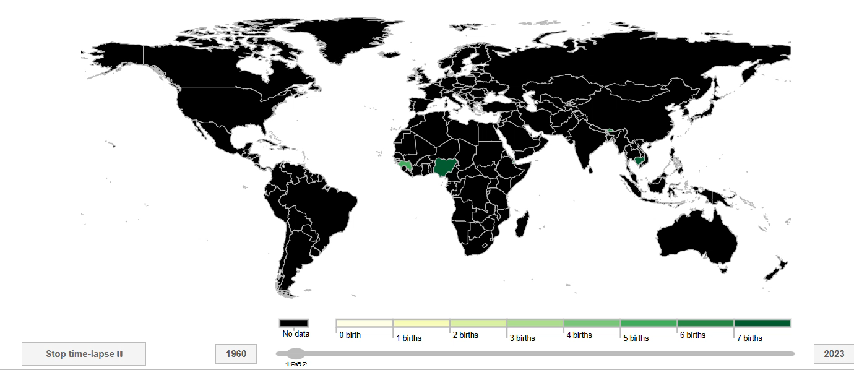
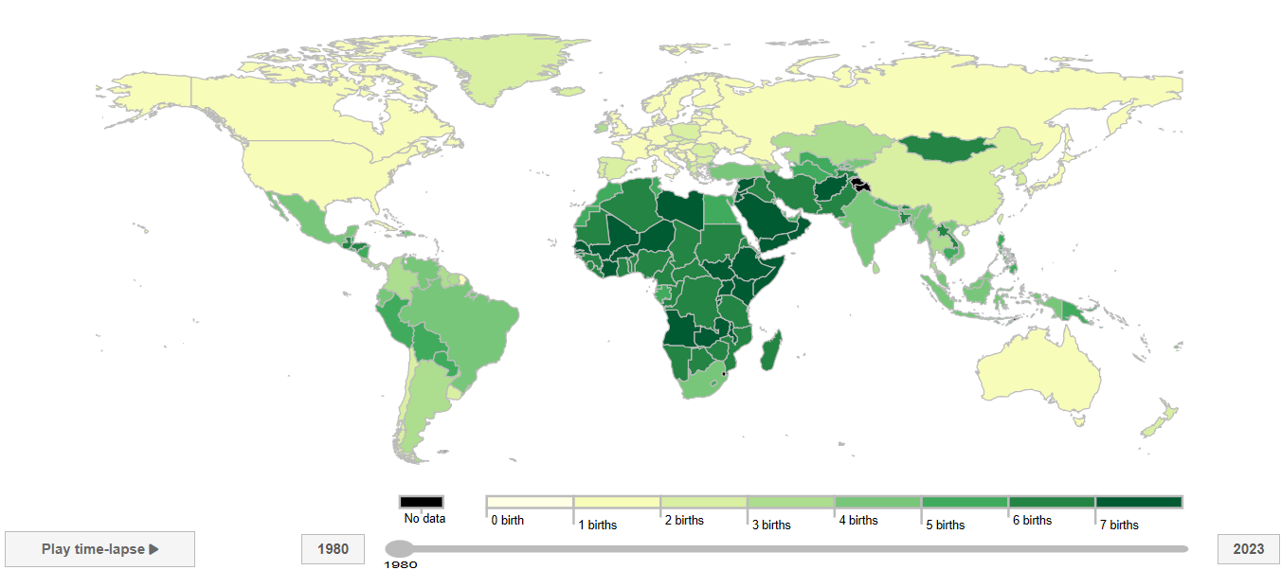
Dataset Sources Change
From
To

Slide 5
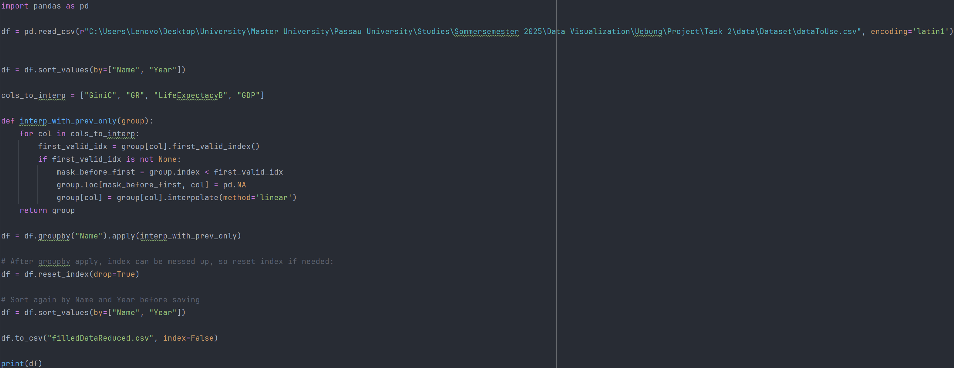
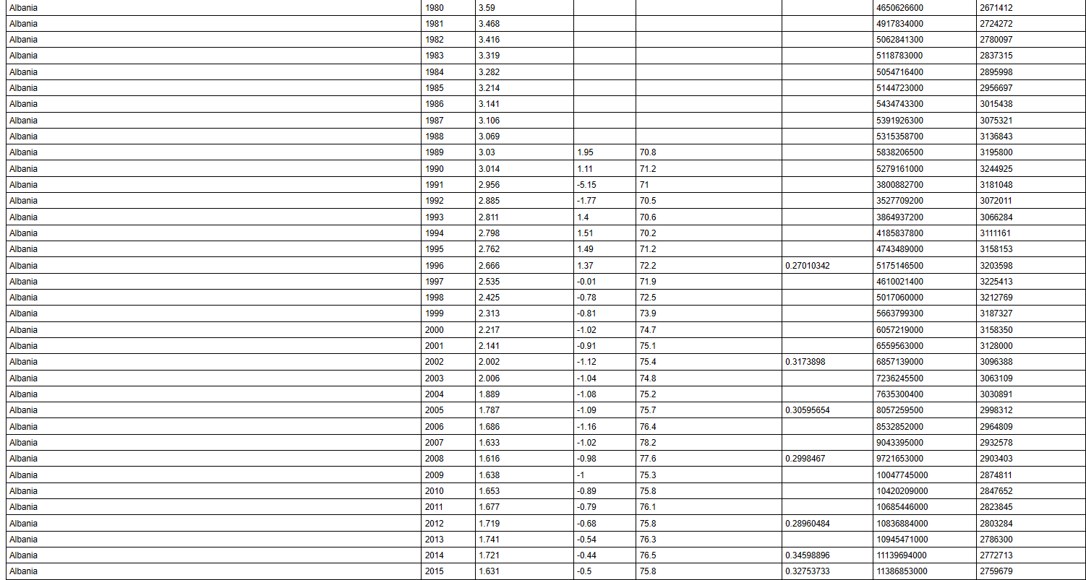
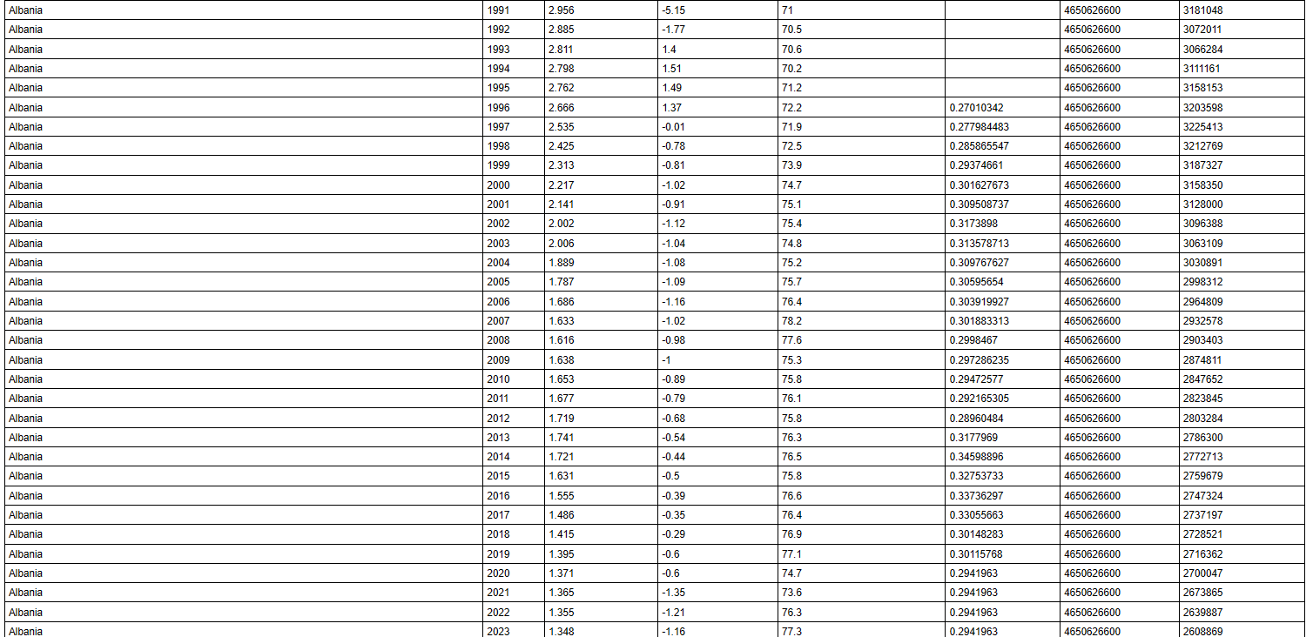
Data Interpolation

Slide 6
Project DEMO

Slide 7
Summary
Overall Insights Toolset:
- Global fertility rate has slowly decreased over time from 1980 to 2023
- Countries with high GDP generally had lower fertility rate than countries with low GDP
- Fertility rate was positively correlated with infant mortality rate and negatively correlated with life expectancy
- GINI coefficient(inequality levels) stayed consistent for most countries and did not have a meaningful effect on fertility rate.

